Slide 1
Principles and ethics of Artificial Intelligence
Module II
Hazina
Asst.Prof.
DCSKU

Slide 2
key pillars of ethical AI.
Accountability
Reliability
Explainability
Security
Privacy

Slide 3
Artificial Intelligence Code of Ethics
Why are AI ethics important?
What is an AI code of ethics?
A proactive approach to ensuring ethical AI,
Policy
Education.
Technology
Ethical AI policies will need to address how to deal with legal issues when something goes wrong.
Notes:
Asilomar AI Principles-Assignment.

Slide 4
Artificial Intelligence Code of Ethics
Establishes the general ethical principles and standards of conduct that should be followed by participants in relation to the field of artificial intelligence(AI Actors ).
The Code applies to relationships related to the ethical aspects of the creation (design, construction, piloting), implementation and use of AI technologies at all stages that are currently not regulated by the legislation .
The recommendations of this Code are designed for Artificial Intelligence Systems(AIS) used exclusively for civil purposes.
The provisions of the Code can be expanded and/or specified for individual groups of AI Actors in industry-specific or local documents on ethics in the field of AI.
The class and purpose of the AIS and the level of possible risks, as well as the specific context and environment in which the AIS are being used.

Slide 5
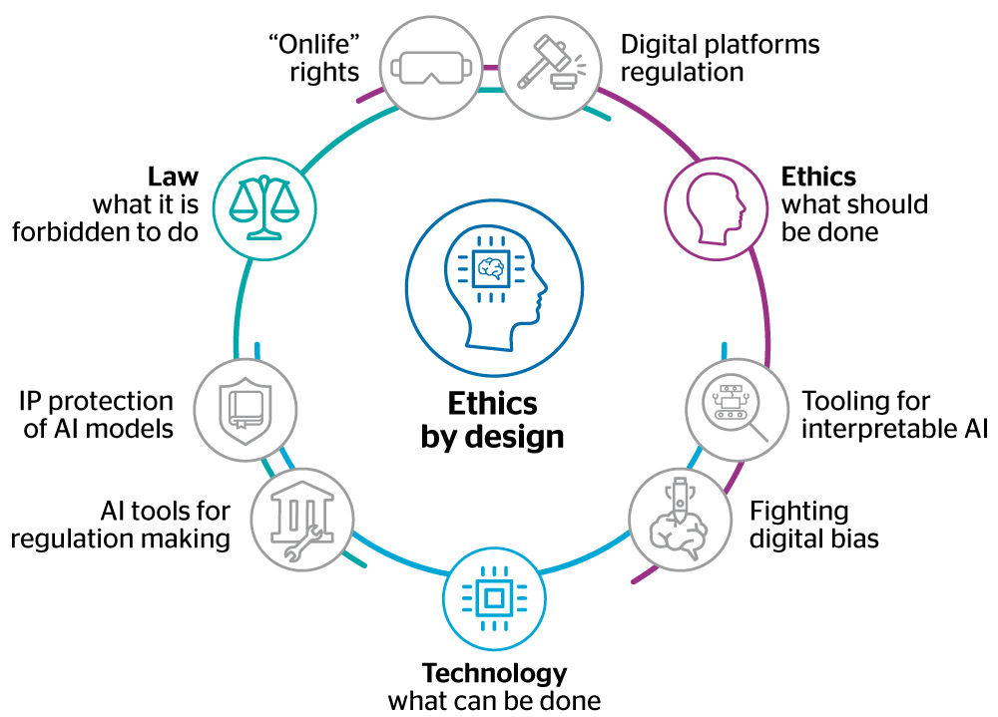

Slide 6
AI CODE OF ETHICS
AI value platform, is a policy statement that formally defines the role of artificial intelligence as it applies to the development and well-being of the human race.
It varies with organizations and administration of the respected field.
For eg. IBM got its code of ethics ,similarly Capegemini, Google etc.

Slide 7
EPISTEMIC STRATEGIES(philosophy)
A special type of cognitive learning strategies that are aimed at validating the knowledge claims raised in expository or informational texts.
Epistemic AI, which focuses on how knowledge is acquired and used within AI.

Slide 8
Modeling the ‘epistemic’ uncertainty stemming from a machine’s partial knowledge of the world, and to develop a mathematical framework to help them manage this uncertainty as effectively as possible.
While traditional ML learns from the (limited) available evidence a model able to describe it, with limited power of generalization (see the figure below, left), epistemic AI (right) starts by assuming that the task at hand is (almost) completely unknown, because of the sheer imbalance between what we know and what we do not know.

Slide 9
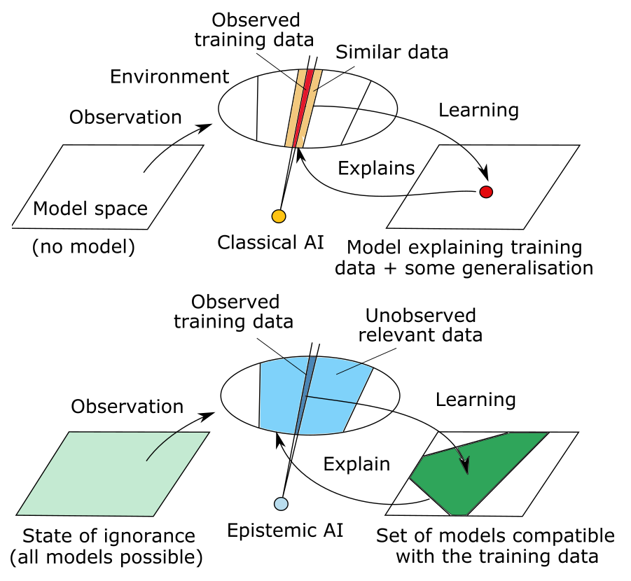
Illustration of the concept of epistemic artificial intelligence. Epistemic AI’s notion of learning (right), as opposed to that of traditional machine learning/artificial intelligence (left).

Slide 10
Confidence Intervals: AI models often provide not just a single prediction but also a confidence interval or a probability distribution associated with their predictions. These intervals can indicate the level of certainty the model has about its predictions. A narrower confidence interval suggests higher epistemic precision, while a broader one indicates greater uncertainty.
Uncertainty Estimation: AI systems can estimate different types of uncertainty, including epistemic uncertainty (related to model parameter uncertainty and data scarcity) and aleatoric uncertainty (related to the inherent randomness in the data). Understanding and quantifying these uncertainties is crucial for assessing epistemic precision.

Slide 11
Model Calibration: Model calibration is the process of ensuring that the predicted probabilities align with the true outcomes. Well-calibrated models are considered to have higher epistemic precision, as they accurately reflect their level of confidence in their predictions.
Out-of-Distribution Detection: Epistemic precision also involves the ability of an AI system to detect when it is facing situations or data points that are outside its training distribution. Models that can recognize out-of-distribution inputs and respond with increased uncertainty are seen as more epistemic ally precise.

Slide 12
Human-AI Collaboration: Epistemic precision in AI is not just about the model's output but also about how well it collaborates with human users. Transparent communication of uncertainties and the ability to engage in a meaningful dialogue about the model's knowledge are important for ensuring that AI systems are used effectively and responsibly.
Model Explainability: Understanding how the AI model arrives at its predictions .Explainable AI techniques aim to make the decision-making process of AI models more transparent, which can help users assess the reliability of the model's outputs.

Slide 13
Continuous Learning: AI models can improve their epistemic precision over time by learning from new data and updating their knowledge. Continuously learning models can adapt to changing conditions and reduce uncertainty.

Slide 14
Precision and reduction of uncertainty
To relate the accuracy and reliability of AI systems.
Precision: The ability of an AI system to provide accurate and specific results or predictions.
It is a measure of how often the AI system's positive predictions are correct.
In other words, it quantifies the proportion of true positive predictions out of all positive predictions made by the system.
Precision is typically calculated using the following formula:
Precision = True Positives / (True Positives + False Positives)

Slide 15
Reduction of Uncertainty:
Reducing uncertainty in AI involves increasing the confidence and reliability of the AI system's predictions or decisions.
Uncertainty can arise from various sources, such as noisy data, limited training examples, or inherent complexity in the problem being solved.

Slide 16
Methods to reduce uncertainty in AI include
Increasing the size and quality of the training data: More data and better data can help AI systems learn more accurate patterns.
Improving model architecture: Using more advanced neural network architectures or algorithms can help capture complex relationships in the data.

Slide 17
Ensemble methods: Combining predictions from multiple models (ensemble learning) can often reduce uncertainty by averaging out errors and improving overall accuracy.
Feature engineering: Carefully selecting and preprocessing features can reduce uncertainty by focusing on the most relevant information.
Bayesian methods and uncertainty quantification techniques, such as Bayesian neural networks and Monte Carlo dropout, are also used to provide probabilistic estimates and quantify uncertainty in AI predictions.

Slide 18
Technological Strategies to Ensure Safe and Beneficial AI
Artificial Intelligence (AI) has the potential to bring about significant benefits to society, but it also poses inherent risks. To harness the full potential of AI while minimizing harm, it is essential to implement technological strategies aimed at ensuring its safety and beneficial use. Here are some key strategies:

Slide 19
Ethical Frameworks: Establish clear ethical guidelines for AI development and use. Encourage responsible AI practices that prioritize transparency, accountability, and fairness. Ethical considerations should underpin the entire AI lifecycle.
AI Bias Mitigation: Address bias in AI systems by using fairness-aware algorithms and robust data collection and preprocessing techniques. Regularly audit AI systems for bias and take corrective actions when bias is detected.

Slide 20
Explainable AI (XAI): Implement Explainable AI techniques that provide interpretable explanations for AI decisions. This transparency not only enhances trust but also helps identify potential issues or errors.
Data Privacy: Prioritize data privacy by adhering to data protection regulations and employing secure data handling practices. User consent, transparency, and data anonymization should be integral to AI development.

Slide 21
AI Regulation and Compliance: Stay informed about evolving AI regulations and ensure compliance with relevant standards. This includes addressing safety, fairness, and transparency requirements as mandated by regulators.
Secure Development Methodologies: Integrate secure development methodologies into the AI development process. This includes identifying and mitigating security vulnerabilities and conducting thorough testing.

Slide 22
Continuous Monitoring: Implement continuous monitoring and auditing of AI systems in real-world applications. Regularly assess and update models to ensure they perform as expected and remain secure.
Best Practices: Encourage best practices such as responsible data sharing, model versioning, and lifecycle management. Collaboration with experts and stakeholders can help improve AI systems.

Slide 23
Case Studies and Knowledge Sharing: Learn from case studies and real-world examples of successful AI implementations. Sharing knowledge and lessons learned can guide AI developers towards safer and more beneficial solutions.

